Slide 1
Off-Path Hacking: The Illusion of Challenge-Response Authentication
-Yossi Giladz, Amir Herzbergyz, Haya Shulman

Slide 2
OBJECTIVE
This paper discusses
the vulnerabilities in the network
the method used during off-path hacking
the need for adoption of cryptographic mechanisms.

Slide 3
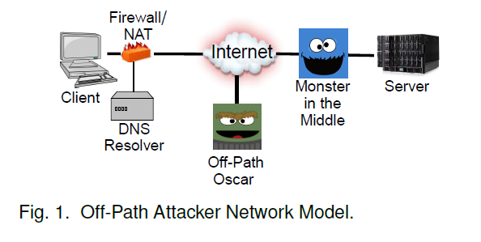
INTRODUCTION
Man-in-the-Middle (MitM) attackers
located on the path of the communicating parties
intercept, modify, block and inject spoofed packets
Under utilisation of cryptography : 2 false beliefs
in reality, attackers can rarely obtain MitM capabilities
non-cryptographic, Internet protocols already provide sufficient protection against typical, common attackers, and in particular, against offpath attackers.

Slide 4
INTRODUCTION
Circumvention of challenge-response defenses : distinguish between (spoofed) packets from an off-path attacker and (legitimate) packets from legitimate communication endpoint.
To authenticate a response from a server, a client sends a random challenge with the request, which is echoed in the response.
Oscar(off-path attacker) cannot eavesdrop on packets

Slide 5
Reason for vulnerability
DNS uses a random 16-bit TXID (transaction identifier) field.
TCP’s main defense is the random 32-bit ISN (initial sequence number) and 16-bit source port.
Challenge-response defenses may fail in several ways:
Insufficient entropy: challenges may be insufficiently-long or non-uniform.
Piggybacking: attacker may ‘piggyback’ fake content, onto valid responses, exploiting IP fragmentation.
Side-channels: attacker may reduce the entropy of the challenge, by exploiting
the fact that challenges mostly or wholly reuse existing protocol fields.

Slide 6
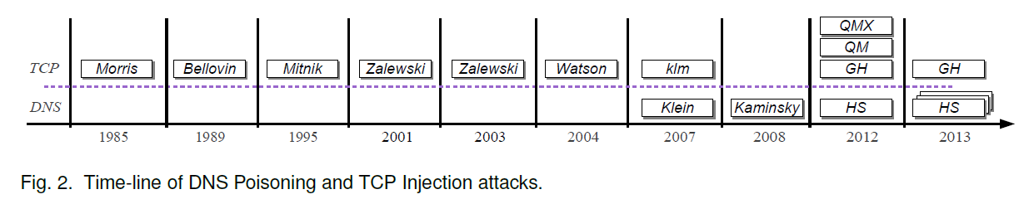
History of Off-Path Attacks
Off-path attacks - TCP injection and DNS poisoning
1985 - TCP injection attack based on the use of predictable sequence numbers.
1989 – Bellovin presented vulnerabilities of (some) TCP implementations to off-path attacks, and discussed potential exploits and defenses.
1995 – notorious TCP injection attack by Mitnick

Slide 7
History of Off-Path Attacks
2001 – Zalewski showed that most implementations are still ‘sufficiently predictable’, allowing off-path attacks.
2003 - Zalewski also commented that ‘piggybacking’ on fragmented TCP traffic may allow injection attacks.
2004 – Waston presented simple TCP injection attack using RST packet.
2007 –
a TCP injection attack presented by the pseudonym author klm
a DNS poisoning attack exploiting poor random-number generators
2008 - Kaminsky presented an even more significant DNS poisoning attack

Slide 8
Malicious Agents
Present in the victim’s network or host
A zombie is a machine controlled by the adversary,
e.g.,compromised by malware, in the victim’s network.
A puppet is weaker agent: a restricted malicious script or applet running in web-browser sandbox.
a client in the victim network ‘surfs’ to the attacker’s web-site, enabling the adversary to run such a script.

Slide 9
DNS CACHE POISONING
The resolvers send the challenges, e.g., in form of a random 16-bit TXID field within the request, and validate that the same values appear in responses.
Kaminsky’s DNS Cache Poisoning
a random TXID and (fixed) source port, which at that time was 53
(1) the attacker triggers a DNS request for a random sub-domain of the victim domain $1.foo.com.
(2) DNS resolver receives the request and forwards it to the target name server.
(3) the attacker sends 2¹⁶ responses with spoofed source IP(name server); each response is a referral mapping of the name server ns.foo.com to 6.6.6.6, an IP address controlled by the attacker.
(4) the response containing the correct TXID is accepted, cached and returned to the client.
(5) authentic DNS response is ignored, since there is no matching pending request.
If the attack fails, i.e., an authentic response from the real name server arrived before the correct response from the attacker, the attack is repeated with a new random subdomain $2.foo.com.

Slide 10
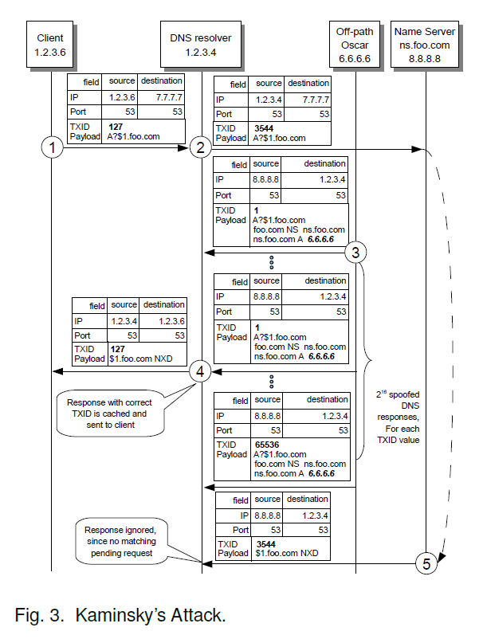

Slide 11
DNS CACHE POISONING
Vulnerability of Resolvers Behind NAT
PER-DESTINATION PORTS ALLOCATION : For a tuple defined by <src-IP:src-port,dst-IP:dst-port,protocol>, a per-destination NAT selects the first port at random, and subsequent ports are increased sequentially
PREDICT-THEN-POISON ATTACK : Off-path attacker, Oscar, controls a zombie, i.e., non-privileged malware, that runs on a client host in the LAN.
The attack is composed of two phases : port prediction and poisoning.

Slide 12
Vulnerability of Resolvers Behind NAT
(1) The zombie sends a packet to create a mapping in the NAT table; we assume
arbitrarily that port 6666 was selected.
(2) Then, Oscar at address 6.6.6.6 sends 2¹⁶ packets with a spoofed source IP of 8.8.8.8 each to a different port of the NAT and each contains the destination port in its payload;
only the packet to port 6666 arrives at the zombie.
(3) The zombie increments this port by 1, in our example the result is 6667, and sends it to Oscar;
this is the external port that will be allocated by the NAT to the subsequent DNS request of the resolver to the victim name server.

Slide 13
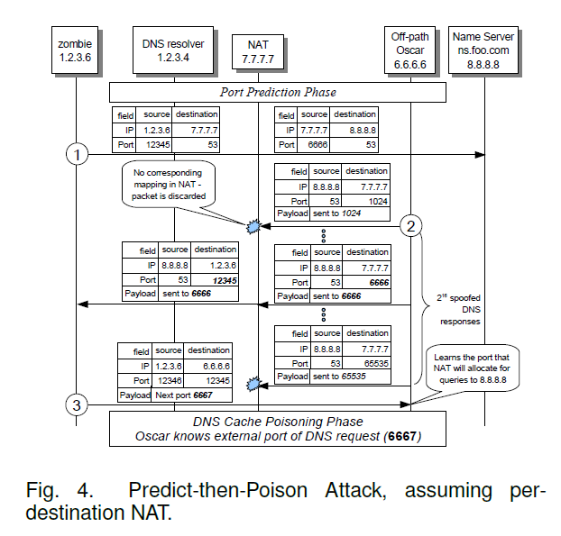

Slide 14
Empirical Evaluation
DNS poisoning results :
the viability attacks such as predict-and-poison (and others) depends mainly on the port allocation method at the NAT.
tested the attacks against eight popular NAT devices:
2 used sequential port allocation (Linux Netfilter and Windows ICS), and hence were vulnerable to the predict-then-poison attack
Five NAT devices (Fedora, Wingate, FreeBSD, Cisco IOS and Cisco ASA) were vulnerable to the trap attacks
Only one (Checkpoint FW-1) was immune to the attacks

Slide 15
TCP INJECTIONS
Off-path TCP injection attacks operate in two phases:
(1) Learn Connection Four-Tuple : learn the four parameters of a TCP connection between a client and a server, that is, their respective IP addresses and ports.
(2) Learn Sequence Number : learn the current sequence number, for packets sent from the server to the client or vise versa.
Learn Connection Four-Tuple
a puppet running on the client machine opens a connection.
Since Oscar opens the connection the server’s IP address and port are known.
To detect client port, Oscar observes p₁ and p₂, the client ports used in the connection to his sites.
If p₂ = p₁ +2, then he learns that the connection to the server is via port p₁ +1

Slide 16
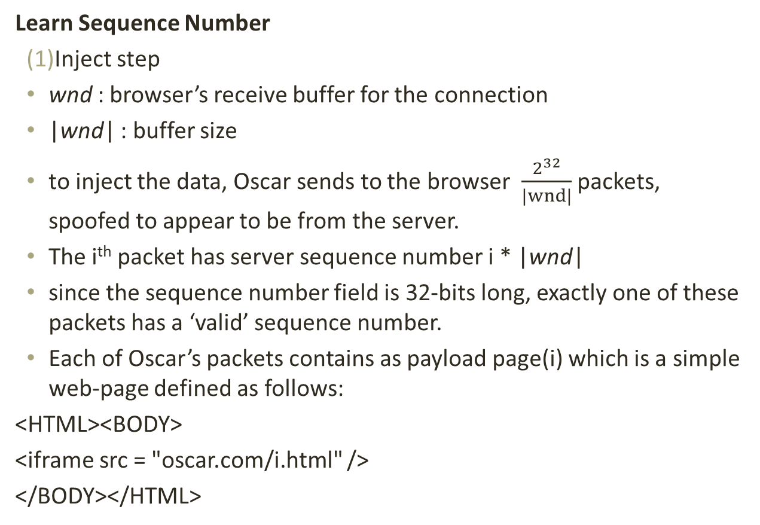
TCP INJECTIONS
Learn Sequence Number
Inject step
wnd : browser’s receive buffer for the connection
|wnd| : buffer size
to inject the data, Oscar sends to the browser $\frac{2^{32}}{|wnd|}$packets, spoofed to appear to be from the server.
The i^{th} packet has server sequence number i * |wnd|
since the sequence number field is 32-bits long, exactly one of these packets has a ‘valid’ sequence number.
Each of Oscar’s packets contains as payload page(i) which is a simple web-page defined as follows:
<HTML><BODY>
<iframe src = "oscar.com/i.html" />
</BODY></HTML>

Slide 17
TCP INJECTIONS
(2) Observe step
the puppet makes prevalent requests to the server, until it reaches the data injected by Oscar in the previous step.
Each server response that arrives at the client shifts wnd forward
after several such responses arrive, there is no gap of unreceived bytes between the injected data and the beginning of wnd.
the browser reads the injected response, assuming that it corresponds to the request.
When the browser renders page(i), it tries to retrieve i.html from Oscar’s web-site providing to Oscar the value of i.
The value of i allows Oscar to compute the next server sequence number that the client expects.

Slide 18
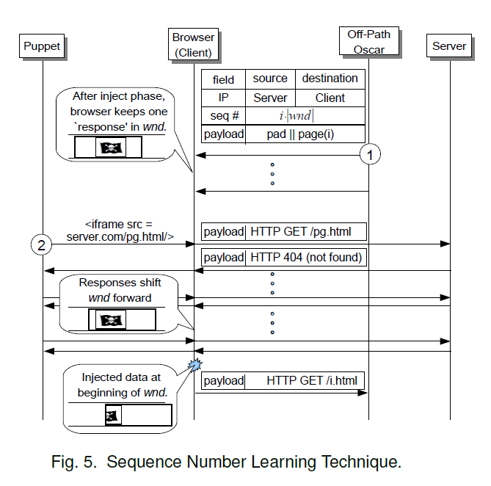

Slide 19
EXPLOITING INJECTION AND POISONING
Exploiting DNS poisoning is straightforward.
allows circumvention of security mechanisms
Exploiting TCP injections is more challenging
TCP is a transport protocol
does not involve caching
to cause long-term impact similar to DNS poisoning, attackers can exploit caching of objects by web caches

Slide 20
CONCLUSIONS
Challenge-response mechanisms against off-path attackers can often be circumvented.
Techniques discussed in this article allow off-path attackers to circumvent the main challenge-response defenses:
source port randomisation
initial sequence number randomisation.
Defenses should be designed and analysed carefully
Deployment of cryptographic defenses to prevent these attacks.

Slide 21
THANK YOU

